Slide 1
Half Wave Rectifier

Slide 2
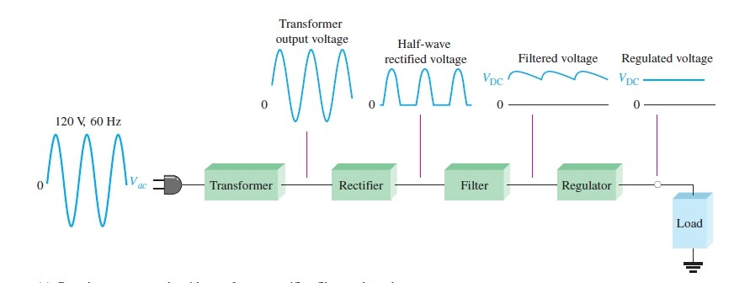
What is a rectifier?
The rectifier converts the ac input voltage to a dc voltage.

Slide 3
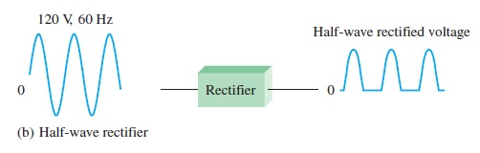
Half-Wave Rectifier

Slide 4
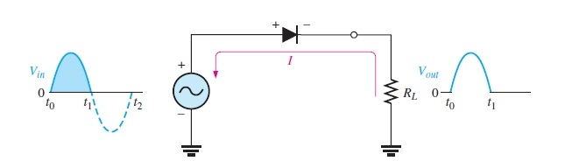

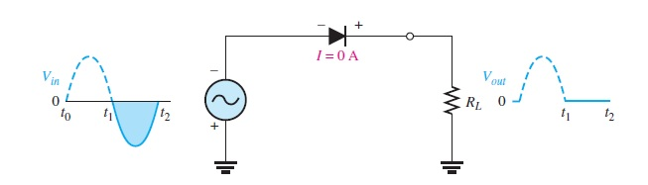
Half-Wave Rectifier Operation

Slide 5

Average Value of the Half-Wave Output Voltage
The average value of the half-wave rectified output voltage is the value you would measure on a dc voltmeter. Mathematically, it is determined by finding the area under the curve over a full cycle, and then dividing by the number of radians in a full cycle i.e 2𝝅

Slide 6
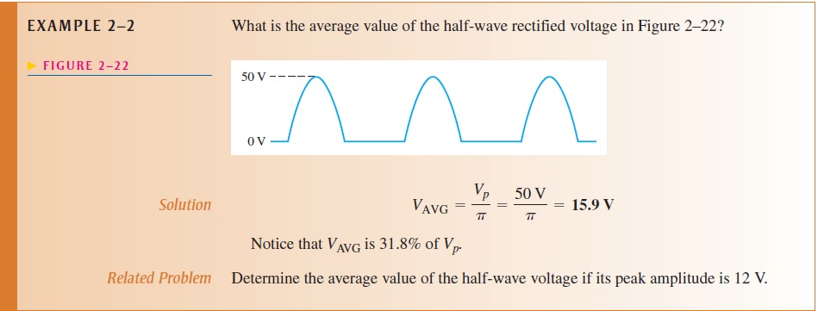

Slide 7
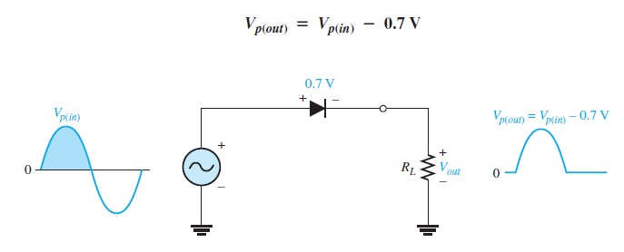
Effect of the Barrier Potential on the Half-Wave Rectifier Output

Slide 8
Peak Inverse Voltage (PIV)
The peak inverse voltage (PIV) equals the peak value of the input voltage, and the diode must be capable of withstanding this amount of repetitive reverse voltage. PIV occurs at the peak of each negative alternation of the input voltage when the diode is reverse-biased. A diode should be rated at least 20% higher than the PIV.

Slide 9
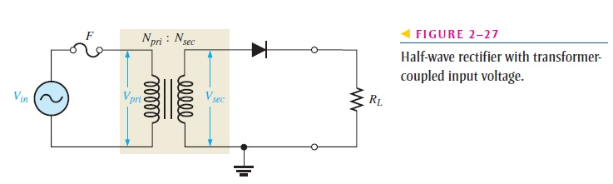
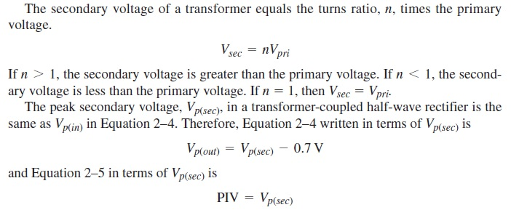
Transformer Coupling

Slide 10
